Slide 1






CEF 440: INTERNET PROGRAMMING
AND MOBILE PROGRAMMING
TASK 4
System Modeling and Design
﻿Group 1

Slide 2


CONTENTS
CEF 440
PHASE OVERVIEW
01
CLASS DIAGRAM
05
CONTEXT DIAGRAM
02
SEQUENCE DIAGRAM
06
DATA FLOW DIAGRAM
03
DEPLOYMENT DIAGRAM
07
USE CASE DIAGRAM
04
THANK YOU
08
01

Slide 3


CEF 440
PHASE OVERVIEW
This project aims to improve road safety, awareness and driving experience by providing real-time notifications to road users about road signs, hazards, and conditions based on their current GPS location.
We focus on how the system is structured, how it interactswith its environment, and how
different components work together to deliver its core functionality.
01

Slide 4
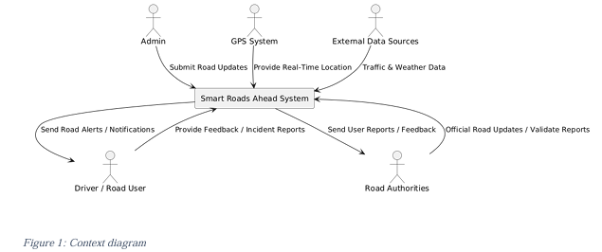
CEF 440
CONTEXT DIAGRAM
Shows the system as a single process and how it interacts with external entities.
The admin, who is responsible for inputting and updating road information such as road signs and conditions.
The Driver or Road user, who receives timely notifications from the system while driving.
The GPS System, which continuously provides the user’s current location to the system.
02

Slide 5
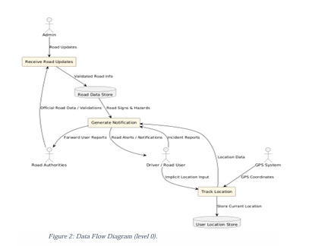
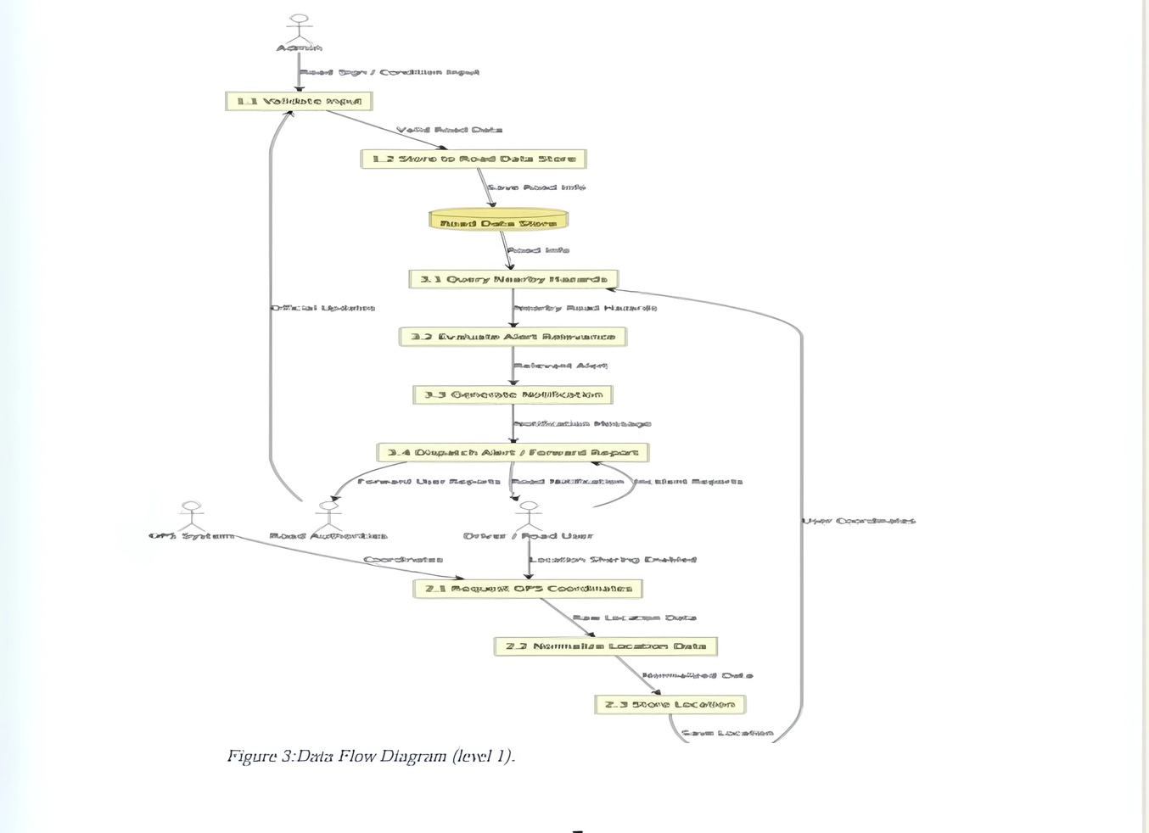
CEF 440
DATA FLOW DIAGRAM
Helps us understand how data moves through the system from external sources into processing units, and then out as useful information (road notifications)
DATA FLOWS
User to System: "Provides Input/Requests Info"
System to User: "Provides Notifications/Information"
External Data Sources to System: "Provides Traffic/Weather Data"
Road Authorities to System: "Manages Road Data/Validates Reports"
System to Road Authorities: "Sends User Reports"
LEVEL 0
LEVEL 1
There are 3 central processes:
Process 1:
Receive Road Updates
Process 2:
Track location
Process 3:
Generate Notification
03

Slide 6
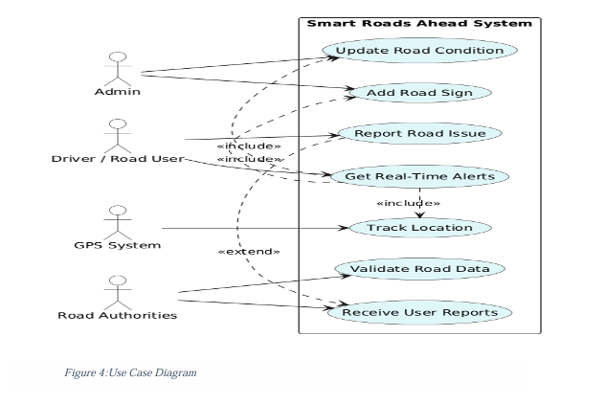

CEF 440
USE CASE DIAGRAM
Helps us visualize how users interact with the system.
The Admin can add road signs like speed limits or stop signs and update road conditions
The Driver/Road User can view notifications and receive real-time alerts
The System also tracks users real-time location using the GPS
04

Slide 7
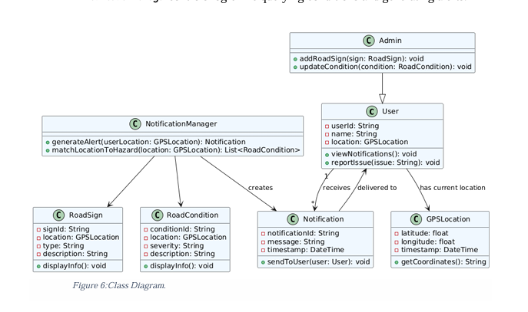

CEF 440
Class Diagram
Shows the system’s main components (as classes), their attributes, operations, and their relationships. The class diagram gives a clear blueprint for out system’s architechture
User and Admin interact with RoadSign, RoadCondition, and Notification.
GPSLocation is a shared class for all entities needing coordinates.
NotificationManager controls logic like querying conditions and generating alerts.
05

Slide 8

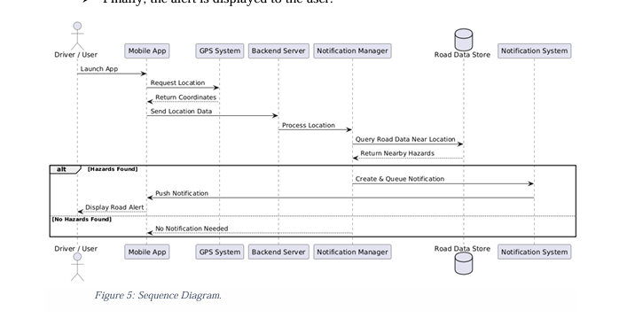
CEF 440
SEQUENCE DIAGRAM
1. The user opens the app, which checks for location access.
2. If enabled, it fetches real-time traffic, weather, and road sign data from APIs and databases.
3. If disabled, it shows an error message.
4. Processed data triggers personalized alerts sent via the notification system.
5. Users can optionally submit feedback, which is stored for improvements.
06

Slide 9
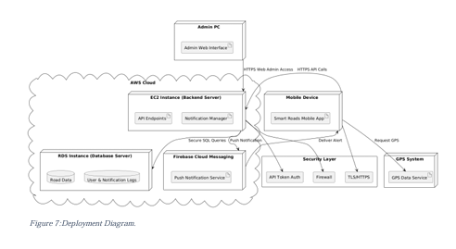
CEF 440
DEPLOYMENT DIAGRAM
Shows how the system is physically set up (the entire Architecture); from the Hardware Nodes and devices to the communication and Interraction between them
➢ A mobile device runs the app.
➢ An Admin PC connects to a cloud backend.
➢ The backend server manages logic and data via APIs and the Notification Manager.
➢ The GPS system supplies real-time location data.
07

Slide 10


CEF 440
THANK
YOU
Group 1
End

